Slide 1

Multiple Plots
David Okeke
CTEC 298
September 23, 2021

Slide 2

What is Matplotlib?
Matplotlib is a comprehensive library for creating static, animated, and interactive visualizations in Python.

Slide 3
Overview of Multiple Plots
We can draw several graphs in a single plot with Matplotlib in two methods. The first is by using the subplot() method, and the second is by superimposing the second graph on the first, resulting in all graphs appearing on the same plot. We'll take a look at both options one by one.

Slide 4
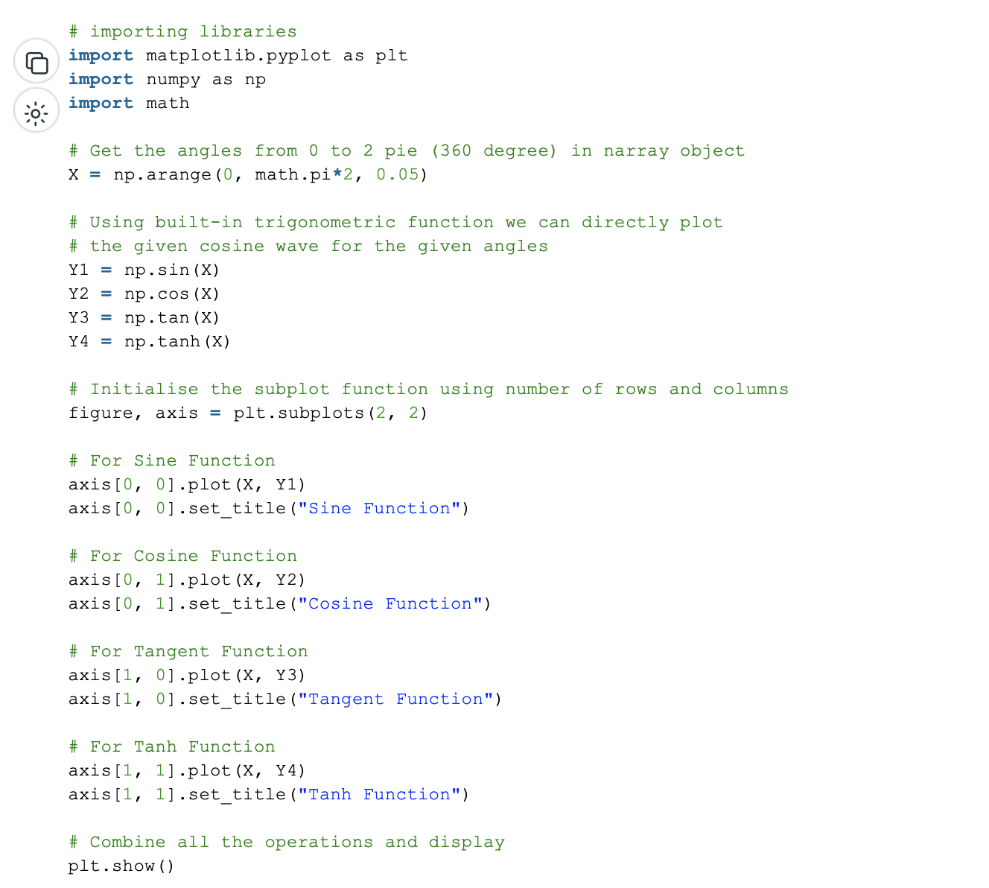
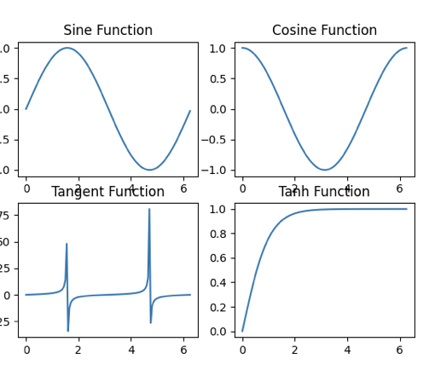
How To Create Multiple Plots In Matplotlib
To create multiple plots use matplotlib.pyplot.subplots method which returns the figure along with Axes object or array of Axes object. nrows, ncols attributes of subplots() method determine the number of rows and columns of the subplot grid.

Slide 5
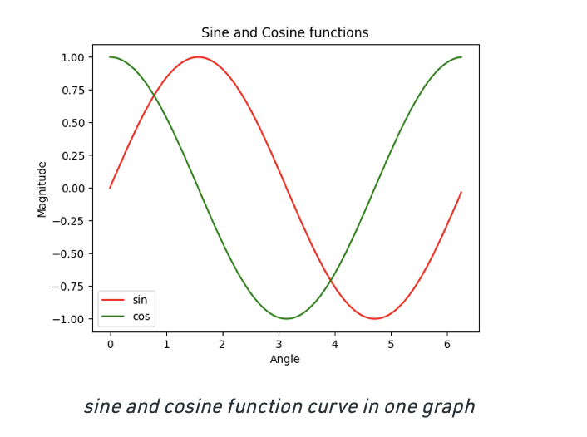
How To Create Multiple Plots In Matplotlib
In this method, we don't utilize any special functions in this manner; instead, we draw the curves one atop the other and try to set the scale.

Slide 6
Thank you

